Slide 1
Automatic Sarcasm Detection: A Survey
ADITYA JOSHI, IITB-Monash Research Academy
PUSHPAK BHATTACHARYYA, Indian Institute of Technology Bombay
MARK J. CARMAN, Monash University

Slide 2
1. Introduction
The Free Dictionary defines sarcasm as
a form of verbal irony that is intended to express contempt or ridicule
Sarcasm has a negative implied sentiment, but may not have a negative surface sentiment.
A sarcastic sentence may carry
positive surface sentiment
e.g. “Visiting dentists is so much fun! ”
negative surface sentiment
e.g. “His performance in Olympics has been terrible anyway” as a response to the criticism of an Olympic medalist
no surface sentiment
e.g., the idiomatic expression “and I am the Queen of England ” is used to express sarcasm

Slide 3
2. Sarcasm Studies in Linguistics
Characteristics of sarcasm
Occurs along several dimensions [11]
namely, failed expectation, pragmatic insincerity, negative tension, and the presence of a victim
Can be understood in terms of the response it elicits [16]
may be laughter, no response, smile, sarcasm (in retort), a change of topic, literal reply, and non-verbal reactions(a popular non-verbal reaction would be rolling one’s eyes).
Arises when there is situational disparity between text and contextual information [76]
e.g. “I love being ignored”

Slide 4
2. Sarcasm Studies in Linguistics
Types of sarcasm [10]
Propositional (主张的)
The statement appears to be a proposition but has an implicit sentiment involved.
e.g. “Your plan sounds fantastic! ” This sentence may be interpreted as non-sarcastic, if the context is not understood
Embedded
Embedded incongruity in the form of words and phrases themselves.
e.g. “John has turned out to be such a diplomat that no one takes him seriously.”
Like-prefixed
A like-phrase provides an implied denial of the argument being made
e. g. “Like you care! ”
Illocutionary (语言外表现行为的)
This kind of sarcasm involves non-textual clues that indicate an attitude opposite to a sincere utterance.
e.g. rolling one’s eyes when saying “Yeah right.”
The examples above are from Reference [77].

Slide 5
2. Sarcasm Studies in Linguistics
Tuple-representation of sarcasm [29]
Sarcasm can be represented as a 6-tuple consisting of <S, H, C, u, p, p'>
S = Speaker, H = Hearer, C = Context, u =Utterance, p = Literal Proposition, p'= Intended Proposition
Read as “Speaker S generates an utterance u in Context C meaning proposition p but intending that hearer H understands p.”
e.g. if a teacher says to a student, “That’s how assignments should be done!” and if the student knows that they have barely completed the assignment, they would understand the sarcasm
S: Teacher
H: Student
C: The student has not completed his/her assignment.
u: “That’s how assignments should be done!”
p: The student has done a good job at the assignment.
p’: The student has done a bad job at the assignment.

Slide 6
2. Sarcasm Studies in Linguistics
Echoic mention theory [64] (回应提述理论)
Irony and sarcasm are most easily comprehended by a listener when the speaker explicitly ‘echoes’ a previous utterance or some shared norm rather than when the speaker only implicitly alludes to the same information.
e.g. “I love it when I do not forward a chain mail and I die the next day.”
The intention of the speaker is to remind the listener of situations where chain mails do not have any result.
Echoic reminder theory [39] (回应提醒理论)
Listeners recognize sarcasm when they perceive that a speaker is alluding(暗指) to some antecedent state of affairs.
e.g. “Visits to a dentist are fun”
Positive statements do not require explicit antecedents because such statements may implicitly allude to societal norms and expectations, and these norms are almost invariably positive.
e.g. "A fine friend you are” can readily be used sarcastically
Negative statements, however, cannot implicitly allude to such positive norms, and so they should require explicit antecedents if they are to be understood.
e.g. "You're a terrible friend” can be used sarcastically only under special circumstances
[39] Roger J. Kreuz and Sam Glucksberg. 1989. How to be sarcastic: The echoic reminder theory of verbal irony. J. Exp.Psychol.: Gen. 118, 4 (1989), 374.
[64] Dan Sperber. 1984. Verbal irony: Pretense or echoic mention? J. Exp. Psychol.: Gen. 113, 1 (1984), 130–136.

Slide 7
2. Sarcasm Studies in Linguistics
Sarcasm as a dropped negation [25]
Irony/sarcasm is a form of negation in which an explicit negation marker (like “not”) is lacking.
e.g. “Being awake at 4 am with a headache is fun.”

Slide 8
2. Sarcasm Studies in Linguistics
Sarcasm is a verbal irony that has an intention to be mocking/ridiculing towards an entity. However, what context is required for the sarcasm to be understood forms a crucial component.
e.g. “I love being ignored”
likely to be sarcastic for all speakers
e.g. “I love solving math problems all day.”
likely to be sarcastic for most speakers
Thus, sarcasm understanding and automatic sarcasm detection are contingent on what information (or context) is known.

Slide 9
2. Sarcasm Studies in Linguistics
Sarcasm can be summarized by a definition by Reference [15]
“A deliberate attempt to point out, question, or ridicule attitudes and beliefs by the use of words and gestures in ways that run counter to their normal meanings.”
purposefully intended by the speaker and not an interpretation of the listener
implied negative sentiment
highlights the relationship of sarcasm with irony
Irony is a situation in which something that was intended to have a particular result has the opposite or a very different result.

Slide 10
2. Sarcasm Studies in Linguistics
Sarcasm consists of
(1) the use of irony
(2) the presence of ridicule
Understanding sarcasm can be divided into the following components:
(1) Identification of shared knowledge
e.g. “I love being ignored”
e.g. “I love solving math problems all weekend”
(2) Identification of what constitutes ridicule
As seen in the linguistic studies, the ridicule may be conveyed through different reactions such as laughter, change of topic, and so on.

Slide 11
2. Sarcasm Studies in Linguistics
Sarcasm is related to other forms of incongruity or figurative language
Sarcasm has an element of ridicule that irony does not [40].
Deception also appears to be closely related to sarcasm.
e.g. “I love this soup,” could be lying (deception) or sarcastic (sarcasm)
The difference between sarcasm and deception lies in shared knowledge between speaker and listener [44].
If the speaker saw a fly floating on the soup
The statement above is likely to have a sarcastic intention
Whether or not the listener understands the sarcasm depends on whether the listener saw the fly in the soup and whether the listener believes that the presence of a fly in a soup makes it bad.

Slide 12
3. Problem Definition
Common formulation for sarcasm detection is a classification task
Given a piece of text, the goal is to predict whether or not it is sarcastic.
Thus, the sentence “I love being ignored” is to be predicted as sarcastic while the sentence “I love being pampered” is to be predicted as non-sarcastic.
Other formulations for sarcasm detection have also been reported
Reference [33] models sarcasm detection for dialogue as a sequence labeling task.
Reference [22] models sarcasm detection as a sense disambiguation task.
The authors state that a word may have a literal sense or a sarcastic sense.
e.g. the word “amazing”
in the sentence “Amazing to see him lose the match in 20 minutes” is used in a sarcastic sense
in the sentence “Amazing to see a brilliant film such as this” is used in a literal (positive) sense.
Reference [51] models sarcasm interpretation as a monolingual machine translation task.
Use two machine translation systems (based on Moses and RNN, respectively) to obtain non-sarcastic interpretations of the sarcastic sentences.

Slide 13
4.1 Dataset - Short Text
Social media makes large-scale user-generated text accessible.
Because of restrictions on text length imposed by some of these platforms, this text tends to be short requiring authors to use abbreviations to fit their statements within the specific limit.
For Twitter-based datasets, two approaches to obtain annotations have been used
Manual annotation
Reference [60] [47]
The use of hashtag-based supervision
A hashtag is a label provided by authors themselves
Rapid creation of large-scale datasets

Slide 14
4.1 Dataset - Short Text
Twitter-based datasets
Reference [13]
A dataset of tweets that are labeled based on the presence of sarcasm indicative hashtags
such as #sarcasm, #sarcastic, #not, and so on.
Reference [26] [58]
Retain only examples where it occurs at the end of a tweet but eliminate cases where the hashtag is a part of the running text.
Reference [59]
A large dataset of 40,000 tweets labeled as sarcastic or not, again using hashtags.
Reference [20]
Hashtag-annotated dataset of tweets
Reference [41]
Use “#not” to download and label their tweets

Slide 15
4.1 Dataset - Short Text
Other social media text
Reference [72]
A corpus of Reddit posts of 10K sentences, from six Reddit topics.
Reference [73]
A dataset of Reddit comments—5,625 sentences.
Reference [37]
A large dataset of manually labeled Reddit comments, including 1.3 million sarcastic comments.

Slide 16
4.2 Dataset - Long Text
Reviews and discussion forum posts have also been used as sarcasm-labeled datasets.
Reference[45]
Internet Argument Corpus, which marks a dataset of discussion forum posts with multiple labels, one of them being sarcasm
Reference [57]
A dataset of movie reviews, book reviews, and news articles marked with sarcasm and sentiment.
Reference [56]
Deals with products that saw a spate of sarcastic reviews all of a sudden. Their dataset consists of 11,000 reviews.
Reference [19]
uses a sarcasm-labeled dataset of around 1,000 reviews.
Reference [9]
Creates a labeled set of 1,254 Amazon reviews, out of which 437 are ironic.
Reference [68]
Consider a large dataset of 66,000 Amazon reviews.
Reference [43]
A dataset of reviews, comments, and so on from multiple sources, such as Amazon, Twitter, Netease, and Netcena.
In these cases, the datasets are manually annotated, because markers like hashtags are not available.

Slide 17
4.3 Dataset - Transcripts and Dialogue
A form of verbal irony and is often expressed in the context of a conversation
Reference [67]
131 call center transcripts. Each occurrence of “yeah right” is marked as sarcastic or not.
The goal is to identify which “yeah right” is sarcastic.
Reference [55]
creates a crowd-sourced dataset of sentences from an MTV show “Daria.”
Reference [33]
A manually annotated transcript of the TV Series “Friends.”
Every “utterance” in a scene is annotated with two labels: sarcastic or not sarcastic.

Slide 18
4.4 Dataset - Miscellaneous Datasets
In addition to the three kinds of datasets above, several other datasets have been reported.
Reference [38]
uses 20 sarcastic and 15 non-sarcastic book excerpts, which are marked by 101 annotators.
The goal is to identify lexical indicators of sarcasm.
Reference [69]
focuses on identifying which similes(明喻) are sarcastic.
For example, the simile “as useful as a chocolate teapot” is to be predicted as sarcastic, while the simile “as big as a plum” is not.
Reference [22]
uses a crowd-sourcing tool to obtain a non-sarcastic version of a sentence if applicable.
For example, “Who doesn’t love being ignored” is expected to be corrected to “Not many love being ignored.”
Reference [48]
creates a manually labeled dataset of quotes from a website called sarcasmsociety.com.
Reference [34]
creates a similar dataset of quotes from GoodReads, a book recommendation website.
However, in this case, they use user-determined tags to assign sarcasm labels.

Slide 19
5. Approaches
Approaches to sarcasm detection can be classified into:
Rule-based
Statistical
Deep learning-based approaches

Slide 20
5.1 Rule-Based Approaches
Attempt to identify sarcasm through specific evidence ( indicators of sarcasm )
Reference [69]
Identifies sarcasm in similes using Google searches to determine how likely a simile is.
Present a nine-step approach where at each step/rule, a simile is validated as non-sarcastic using the number of search results.
Reference [47]
Proposes that hashtag sentiment is a key indicator of sarcasm.
Hashtags are often used by tweet authors to highlight sarcasm, and hence, if the sentiment expressed by a hashtag does not agree with rest of the tweet, the tweet is predicted as sarcastic.
Reference [6]
The first algorithm uses a parse-based lexicon generation algorithm that creates parse trees of sentences and identifies situation phrases that bear sentiment.
If a negative phrase occurs in a positive sentence, then the sentence is predicted as sarcastic.
The second algorithm aims to capture hyperbolic sarcasm
i.e., by using interjections (such as “wow” ) and intensifiers (such as “absolutely”) that occur together.
Reference [60]
Look for a positive verb and a negative situation phrase in a sentence

Slide 21
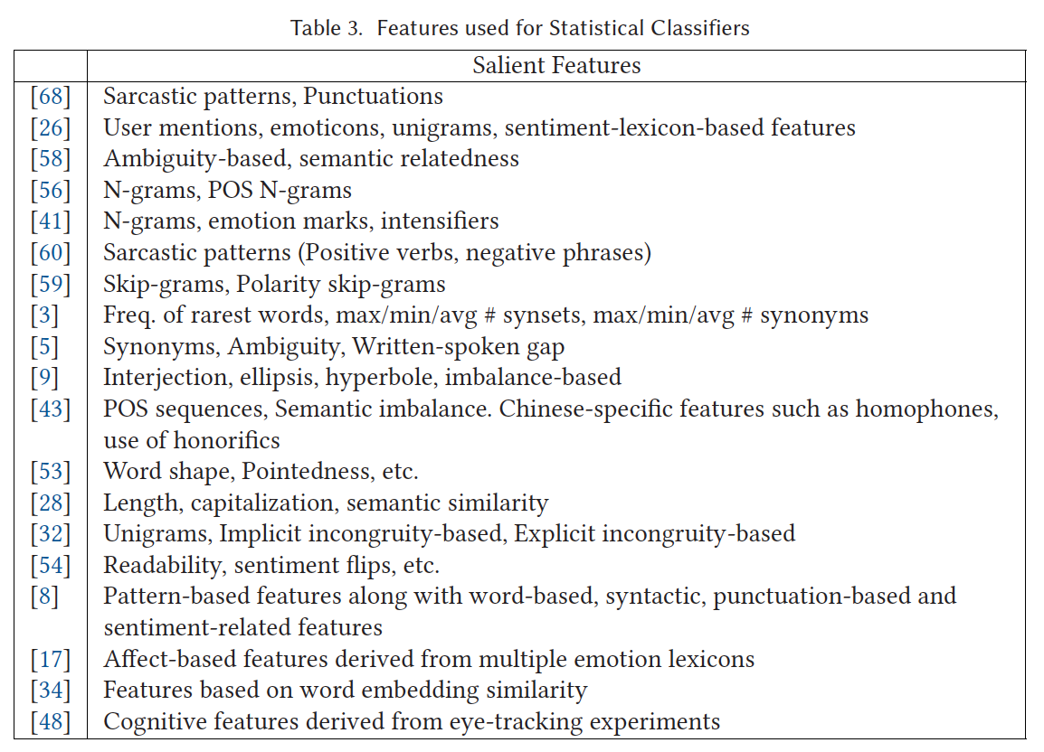
5.2 Feature Sets

Slide 22
5.3 Learning Algorithms
Most work use different forms of Support Vector Machines (SVM) [13, 32, 38, 56, 67, 68]
Reference [34] uses SVM-Perf
Reference [26] uses SVM and Logistic Regression, with the χ2 test used to identify discriminating features.
Reference [60] compares rule-based techniques with a SVM-based classifier.
Reference [41] uses the balanced winnow algorithm to determine high-ranking features.
Reference [59] uses Naive Bayes and Decision Trees for multiple pairs of labels among irony, humor, politics and education.
Reference [2] uses binary Logistic Regression.
Reference [75] uses SVM-HMM to incorporate sequence nature of output labels in a conversation.
Reference [33] validates that for conversational data, sequence labeling algorithms perform better than classification algorithms.
They use SVM-HMM and SEARN as the sequence labeling algorithms.
Reference [43] compare several ensemble-based classification approaches including Bagging, Boosting, and so on.
Reference [49] uses fuzzy Clustering for sarcasm detection.

Slide 23
5.4 Deep Learning-Based Approaches
Reference [34] uses similarity between word embeddings as features for sarcasm detection.
Reference [63] presents a novel Convolutional Network based architecture that learns user embeddings in addition to utterance-based embeddings.
The authors state that it allows them to learn user-specific context.
Reference [21] uses a combination of a Convolutional Neural Network, a Recurrent Neural Network (Long Short-Term Memory) followed by a Deep Neural Network.
They compare their approach against recursive SVM and show an improvement for the deep learning architecture.
Reference [52] investigates the use of Deep Convolutional Networks for sarcasm detection.

Slide 24
5.5 Shared Tasks & Benchmark Datasets
Reference [61] describes a shared task on sentiment analysis in Twitter, from SemEval-2014.
Multiple datasets (SMS, LiveJournal, etc.), one of which was a dataset of sarcastic tweets.
The best performance for the dataset of sarcastic tweets (82.75, versus 77.13, which was the performance of the system that ranked highest) was by Reference [62]. They use features that separately capture message and contextual polarity.
Reference [20] describes a shared task on sentiment analysis of figurative language, from SemEval-2015.
A dataset of ironic and metaphorical statements labeled as positive, negative and neutral.
The teams that participated in the shared task used affective resources, character n-grams, and so on.
The winning team used “four lexica, one that was automatically generated and three that were manually crafted (sic).”
PAKDD 2016
The competition dataset consisted of Reddit comments labeled as either sarcastic or non-sarcastic.
http://www.parrotanalytics.com/pacific-asia-knowledge-discovery-and-data-mining-conference-2016-contest/

Slide 25
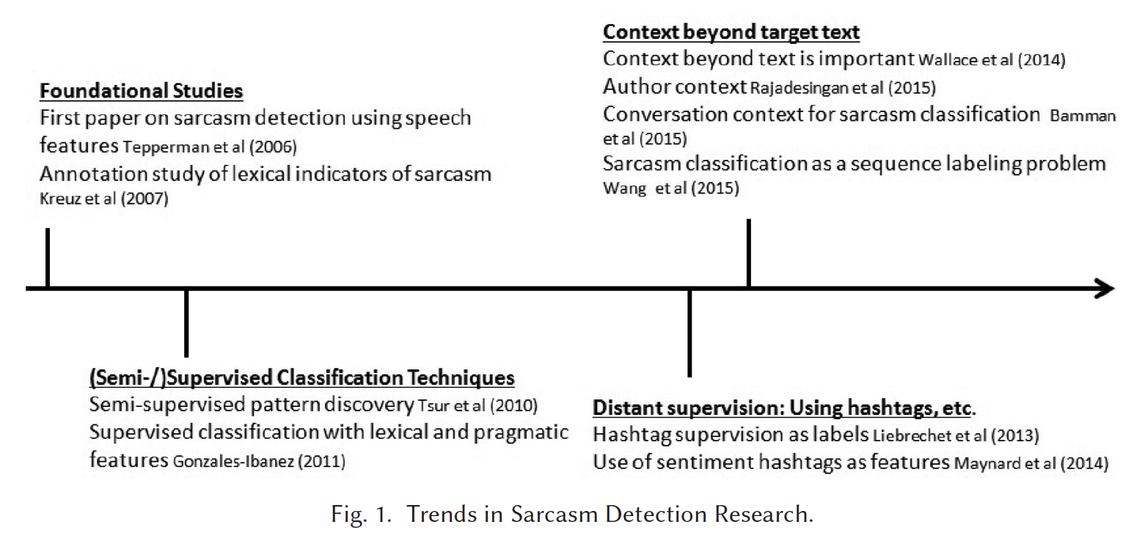
7. Trends in Sarcasm Detection

Slide 26
7.1 Pattern Discovery
Sarcasm may contain implicit sentiment phrases
e.g. “just got off a wonderful 12 hour flight sitting next to a crying baby”
Reference [68]
extracts sarcastic patterns from a seed set of labeled sentences.
first select words that either occur more frequently than an upper threshold or less frequently than a lower threshold.
identify a large set of candidate patterns from among these extracted words.
The patterns that occur discriminatively in either classes are then selected.
References [53] and [8] use a similar approach for Czech and English tweets.

Slide 27
7.1 Pattern Discovery
Reference [60 ]
Hypothesize that sarcasm occurs due to a contrast between positive verbs and phrases indicating negative situations
e.g. “I love being awake at 4 am with a headache”
The algorithm also incorporates subsumption of shorter situation phrases by longer situation phrases.
e.g. “being awake at 4 am ” as in the previous example has an implicit negative sentiment in itself as compared to the longer phrase “being awake at 4am with a headache .”
Reference [32 ] adapts this algorithm by eliminating subsumption.
Reference [45 ]
begins with a seed set of nastiness and sarcasm patterns, created using Amazon Mechanical Turk.
Train a high precision sarcastic post classifier, followed by a high precision non-sarcastic post classifier.
These two classifiers are then used to generate a large labeled dataset, which is in turn used to train a classifier.

Slide 28
7.2 Role of Context in Sarcasm Detection
(skipped)

Slide 29
8.1 Issues with Annotation
Although hashtag-based labeling can provide large-scale supervision, the quality of the dataset may be dubious. This is particularly true in the case of using #not to indicate insincere sentiment.
Reference [41]
shows that #not is often used to express sarcasm—while the rest of the sentence is not sufficient for identifying the sarcasm.
For example, “Looking forward to going back to school tomorrow #not.”
“Looking forward to going back to school tomorrow ”—which may not have a sarcastic interpretation
hashtag-based supervision may cause ambiguities (or be incorrect) in some cases.
Reference [21 ]
train their deep learning-based model using a large dataset of hashtag-annotated tweets
use a test set of manually annotated tweets
In most reported works that use hashtag-based supervision, the hashtag is removed in the pre-processing step.

Slide 30
8.1 Issues with Annotation
Even in the case of manually annotated datasets, the quality of the annotation is a concern. Since sarcasm is a subjective phenomenon, the inter-annotator agreement values reported in past work are diverse.
Reference [68 ] indicates an agreement of 0.34. The value in the case of Reference [18 ] is 0.79, while for Reference [60 ], it is 0.81.
Reference [30 ] performs an interesting study on cross-cultural sarcasm annotation.
compare annotations by Indian and American annotators and show that Indian annotators agree with each other more than their American counterparts.
e.g. “It’s sunny outside and I am at work. Yay ” is considered sarcastic by the American annotators, but non-sarcastic by Indian annotators due to typical Indian climate.

Slide 31
8.2 Issues with Sentiment as a Feature
Several approaches use lexical sentiment as a feature to the sarcasm classifier.
these approaches require ‘surface polarity’: the apparent polarity of a sentence.
Reference [6] predicts a sentence as sarcastic if a negative phrase occurs in a positive sentence.
Reference [36] uses sentiment of a past tweet by the author to predict sarcasm.
Reference [59] captures polarity in terms of two emotion dimensions: activation and pleasantness.
Reference [9] uses a sentiment imbalance feature that is represented by star rating of a review disagreeing with the surface polarity.
Reference [7] cascades sarcasm detection and sentiment detection
observes an improvement of 4% in accuracy for sentiment classification, when sentiment detection is aware of sarcastic nature of text.
Reference [47] also demonstrates the impact of sarcasm detection on sentiment classification using modules from the GATE framework.
Using simple rules to detect sarcasm expressed through hashtags, they improve the performance of sentiment classification by detecting sarcasm.
Observes that sarcasm may not always flip the polarity. The example they quote is: “Its not like I wanted to eat breakfast anyway. #sarcasm.”

Slide 32
8.3 Dealing with Skewed Datasets
Sarcasm is an infrequent phenomenon of sentiment expression. This skew also reflects in datasets.
Reference [68] uses a dataset with a small set of sentences are marked as sarcastic.
12.5% of tweets in the Italian dataset given by Reference [3] are sarcastic.
Reference [55] presents a balanced dataset of 15k tweets.
In some articles, specialized techniques are used to deal with the dataset imbalances.
Reference [43] presents a multi-strategy ensemble learning approach.
Reference [34] uses SVM-perf that performs F-score optimization.
Similarly, to deal with sparse features and skewness of data
Reference [73] introduce an LSS-regularization strategy.
They use a sparsifying L1 regularizer over contextual features and L2-norm for bag of word features.
Data imbalance also influences the choice of performance metrics reported.
Reference [41] reports AUC for balanced as well as skewed datasets, to demonstrate the benefit of their classifier.
Since AUC is known to be a more reliable indicator of performance than F-score for skewed data,
Reference [1] compares performance of sarcasm classification for many datasets of different data imbalances.

Slide 33
9. Conclusion & Future Directions
The current trend of research in sarcasm detection points to the discovery of new features and the incorporation of context. Based on our survey of these works, we observe the following emerging directions:
(1) Quality of sarcasm annotation
Sarcasm is understood on the basis of shared knowledge. As shown in Reference [43], sarcasm is closely related to language/culture-specific traits.
Future approaches to sarcasm detection in new languages will benefit from understanding such traits and incorporating them into their classification frameworks.
Reference [30] shows that American and Indian annotators may have substantial disagreement in their sarcasm annotations. However, this sees a non-significant degradation in the performance of sarcasm detection.
(2) Extraction of implicit sentiment in patterns
Sarcasm is closely linked to sentiment incongruity [32].
Several related works exist for detection of implicit sentiment in sentences
e.g. “The phone gets heated quickly ” versus “The induction cooktop gets heated quickly .”

Slide 34
9. Conclusion & Future Directions
(3) Analysis based on types of sarcasm
Past work does not report which of the types of sarcasm are correctly handled by existing systems.
A dataset that labels sarcastic sentences into one of the four types and then studies the performance of various systems on each of these types will be helpful.
Future work can benefit from reporting which types of sarcasm are proving to be difficult for different approaches.
(4) Sarcasm versus irony classification
Sarcasm and irony are closely related and most work so far considers them to be the same.
Reference [74 ] presents that aggressiveness is the distinguishing factor between the two.
Reference [66 ] presents a set of classifiers that distinguish between sarcasm and irony.
describe an analysis of structural and affective features in tweets.
An important observation that they make is the peculiarity of the hashtag “#not” as a negation marker for sarcasm.

Slide 35
9. Conclusion & Future Directions
(5) Linguistic basis for sarcasm detection
Many sarcasm theories, except the theory of dropped negation (described in Section 2), have not been explored as means for sarcasm detection.
Reference [66] shows that the hashtag “#not” plays a distinct role in sarcastic tweets. This may have correlations with this theory of dropped negation.
Approaches grounded in linguistic theories may yield good results.
(6) Coverage of different forms of sarcasm
In Section 2, we described four species of sarcasm: propositional, lexical, like-prefixed, and illocutionary sarcasm.
Current approaches are limited in handling the last two forms of sarcasm: like-prefixed and illocutionary.
Future work may focus on these forms of sarcasm.
(7) Extraction of Contextual Information using Deep learning-based architectures
As shown in Reference [63], context embeddings can be captured.
Embeddings derived from other forms of context may be useful to capture the additional shared knowledge that is required to understand certain forms of sarcasm.

Slide 36
Reference
Carman, M. J., Carman, M. J., & Carman, M. J. (2017). Automatic Sarcasm Detection: A Survey. ACM.

